Slide 1


BE Project Presentation On “Commodity Stock Recommendations and Price Prediction using Prescriptive Analytics Techniques ”
Smt. Kashibai Navale College of Engineering,Pune
Presented by
Harish Hatmode 18U424 Guided
Pragati Bankar 18U417 By
Vishal Wankhede 18U420 Dr. K. N. Honwadkar
Onkar Kulkarni 18U426

Slide 2
Outline
Sequence Diagram
Architecture Diagram
Use Case Diagram
Data Flow Diagram

Slide 3
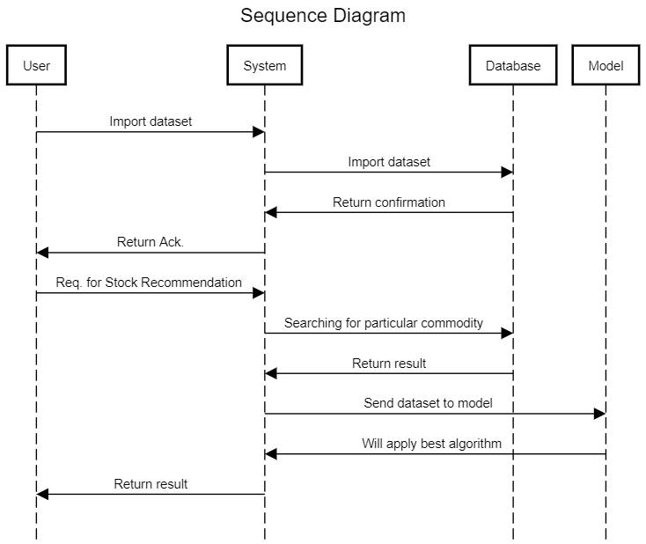

Slide 4
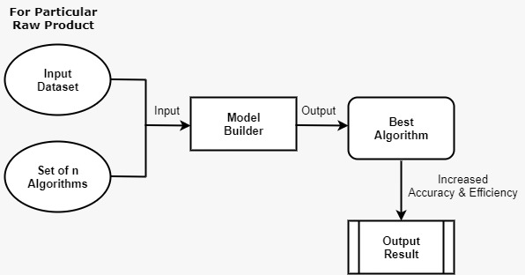
Architecture Diagram

Slide 5
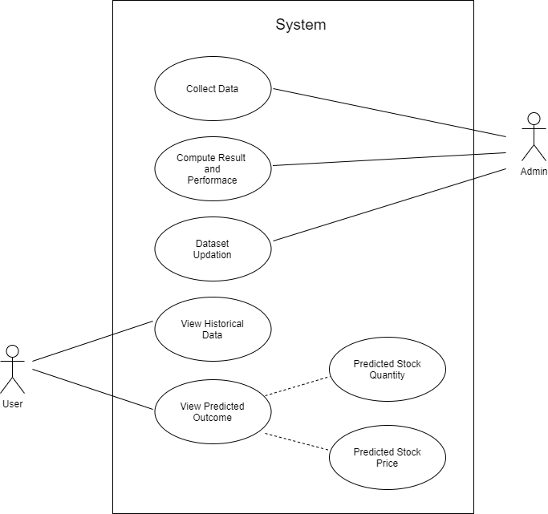
Use Case Diagram

Slide 6
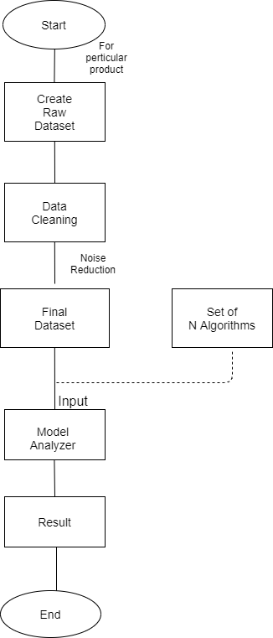
Data Flow Diagram

